Slide 1
World risk analysis
CAPSTONE PROJECT
Presented By:
Jafi Jeya Anbu L
9513- Jayaraj Annapackiam CSI College of Engineering
B.E Mechanical Engineering

Slide 2
OUTLINE
Problem Statement
Proposed System/Solution
System Development Approach
Algorithm & Deployment
Result
Conclusion
Future Scope
References

Slide 3
Problem Statement
Develop a comprehensive world risk analysis framework that evaluates and prioritizes global risks across economic, environmental, geopolitical, and societal domains. The analysis should identify potential threats, assess their likelihood and impact, and propose mitigation strategies to enhance global resilience and preparedness.

Slide 4
Proposed Solution
Risk Identification: Identify and categorize potential risks across various domains such as economic, environmental, geopolitical, and societal. This may include risks like natural disasters, economic recessions, political instability, pandemics, cybersecurity threats, climate change impacts, etc.
Risk Assessment: Evaluate the likelihood and potential impact of each identified risk. Use quantitative and qualitative methods to assess the severity of consequences and the probability of occurrence. Consider historical data, expert opinions, and predictive modeling to inform the assessment.
Prioritization: Prioritize risks based on their severity, likelihood, and potential impact on global stability, economy, environment, and society. Develop a risk ranking or scoring system to prioritize high-risk areas that require immediate attention and mitigation efforts.
Technology Integration: Leverage advanced technologies such as data analytics, artificial intelligence, machine learning, remote sensing, and modeling simulations to enhance the accuracy and predictive capabilities of the risk analysis. Use real-time data and monitoring systems to improve early warning mechanisms and response readiness.
Capacity Building: Invest in capacity building initiatives at the national and international levels to enhance resilience, disaster preparedness, crisis response capabilities, and risk management practices. Empower communities, organizations, and governments with the knowledge, skills, and resources needed to address complex global risks effectively

Slide 5
System Approach
Developing a world risk analysis system involves a systematic approach that integrates various components and methodologies. Here's an outline of the approach:
Define Objectives and Scope: Clearly define the objectives of the risk analysis system, such as identifying global risks, prioritizing them, and developing mitigation strategies. Define the scope of the analysis, including the geographical coverage, risk categories, and time frame.
Data Collection and Aggregation: Gather relevant data from multiple sources, including historical records, scientific studies, government reports, international organizations, expert opinions, and real-time data feeds. Aggregate and organize the data into a structured format for analysis.
Risk Identification: Use data analysis techniques, risk assessment frameworks, and expert knowledge to identify potential risks across different domains such as economic, environmental, geopolitical, technological, and societal. Consider both traditional risks (e.g., natural disasters, economic crises) and emerging risks (e.g., cybersecurity threats, climate change impacts).
Decision Support and Visualization: Provide decision support tools and visualizations to stakeholders, policymakers, and decision-makers to facilitate understanding, analysis, and decision-making. Use dashboards, interactive maps, scenario simulations, risk heat maps, trend analyses, and sensitivity analyses to communicate complex risk information effectively.
Continuous Monitoring and Updating: Establish mechanisms for continuous monitoring, tracking, and updating of risk profiles, indicators, and trends. Use real-time data sources, monitoring systems, early warning systems, and feedback loops to detect emerging risks, assess changing conditions, and update risk assessments and mitigation strategies accordingly.

Slide 6
Algorithm & Deployment
Algorithm for World Risk Analysis
Step 1: Data Collection and Preprocessing
Data Sources: Gather data from various sources such as historical records, scientific studies, government reports, international databases, news feeds, social media, and expert opinions.
Data Preprocessing: Cleanse and preprocess the data by removing duplicates, handling missing values, standardizing formats, and transforming unstructured data into structured formats for analysis.
Step 2: Risk Identification
Domain Classification: Classify data into different risk domains (e.g., economic, environmental, geopolitical, societal) based on predefined categories or machine learning algorithms.
Risk Detection: Use statistical analysis, machine learning models (e.g., clustering, classification), and natural language processing (NLP) techniques to detect potential risks within each domain.
Step 3: Risk Assessment
Quantitative Assessment: Apply quantitative methods (e.g., statistical analysis, predictive modeling) to assess the likelihood and impact of identified risks based on historical data and trend analysis.
Qualitative Assessment: Incorporate qualitative factors (e.g., expert opinions, geopolitical analysis, scenario planning) to evaluate the severity, urgency, and systemic implications of risks.
Step 4: Risk Prioritization
Scoring System: Develop a risk scoring system that considers factors such as severity, probability, exposure, vulnerability, resilience, interconnectedness, and reversibility.
Cost-Benefit Analysis: Perform cost-benefit analysis and feasibility assessments to evaluate the effectiveness, cost-effectiveness, and scalability of mitigation options.
Notes:
Ranking: Rank risks based on their overall scores to prioritize high-risk areas that require immediate attention and mitigation efforts.
Step 5: Mitigation Strategy Generation
Mitigation Options: Generate a range of mitigation strategies for each prioritized risk, including preventive measures, preparedness plans, response protocols, recovery strategies, policy recommendations, and international collaborations.

Slide 7
Deployment of the Algorithm
1. Software Development
Develop a software application or platform that integrates the risk analysis algorithm, data processing modules, visualization tools, and decision support functionalities.
Use programming languages and tools suitable for data analysis (e.g., Python, R), machine learning (e.g., scikit-learn, TensorFlow), and web development (e.g., Flask, Django) to build the application.
2. Cloud Deployment
Deploy the risk analysis software on cloud infrastructure (e.g., AWS, Azure, Google Cloud) to leverage scalability, reliability, and accessibility.
Utilize cloud services for data storage, processing, computation, and real-time updates to accommodate large datasets and dynamic risk assessments.
3. User Interface (UI) Design
Design an intuitive and user-friendly interface for stakeholders, decision-makers, and analysts to interact with the risk analysis system.
Incorporate data visualization tools (e.g., charts, maps, dashboards) to present risk insights, trends, scenarios, and mitigation recommendations effectively.
4. Integration and Automation
Integrate the risk analysis system with external data sources, APIs, and databases for real-time data feeds, automatic updates, and dynamic risk monitoring.
Implement automation features (e.g., scheduled analyses, alerts, notifications) to streamline workflow processes, decision-making, and response actions.

Slide 8
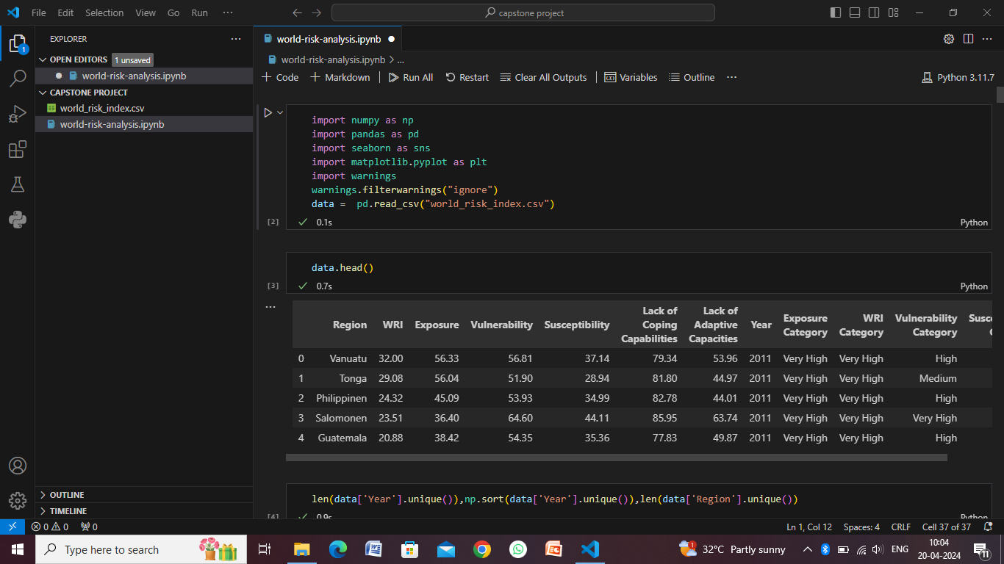
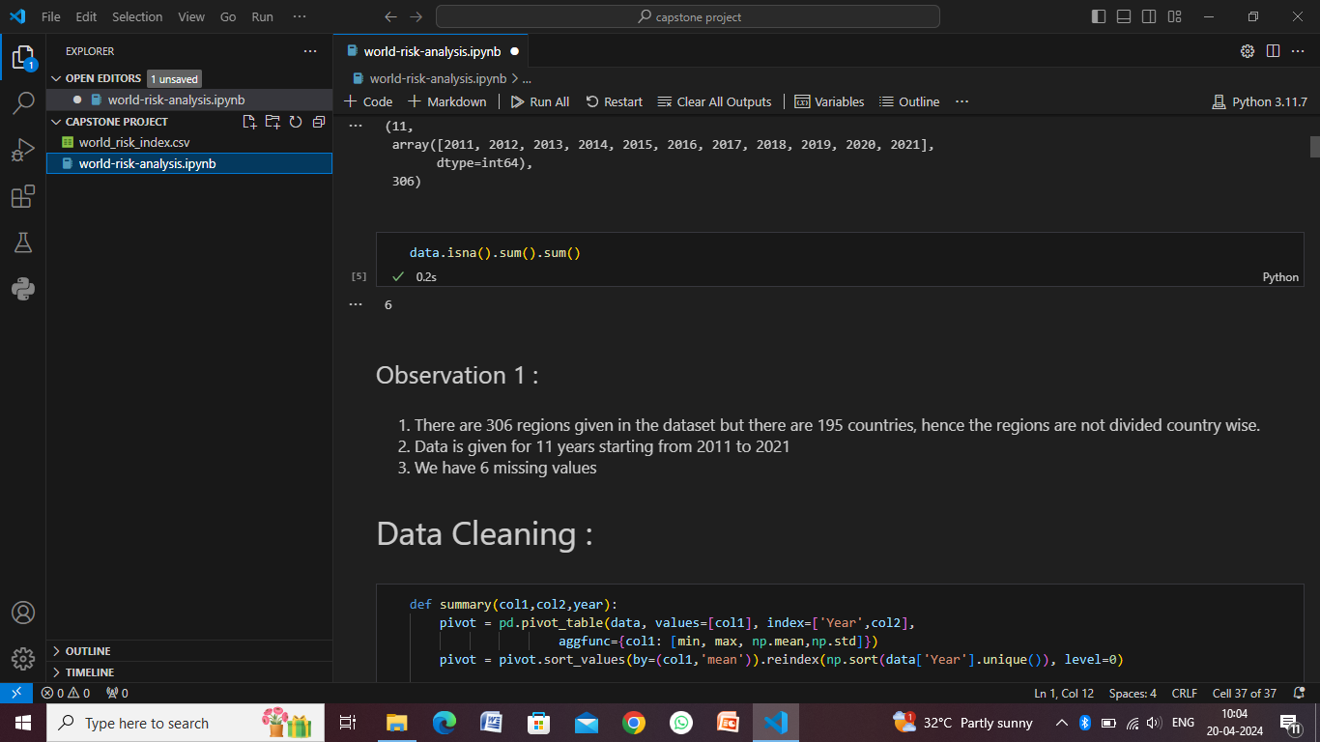
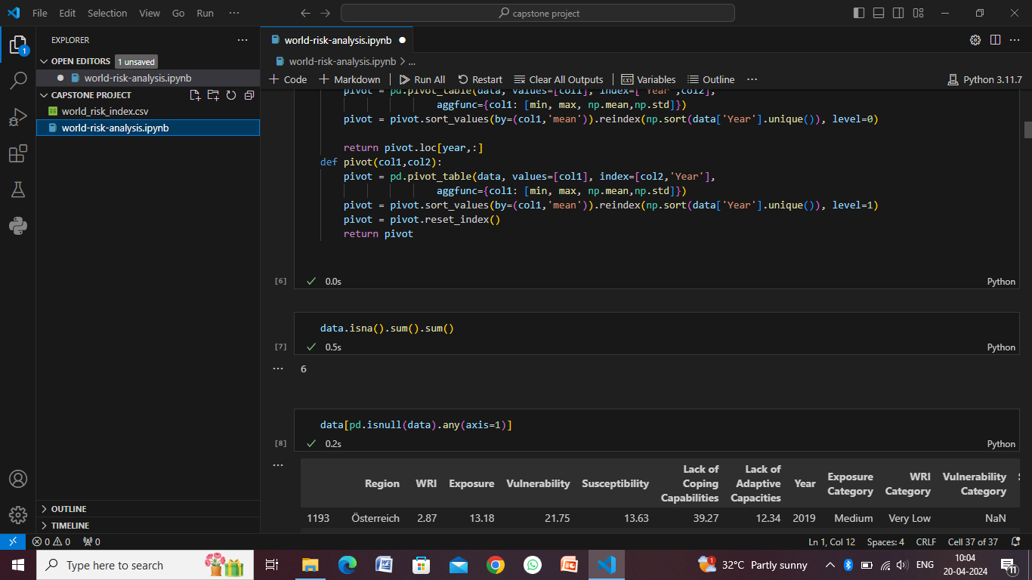
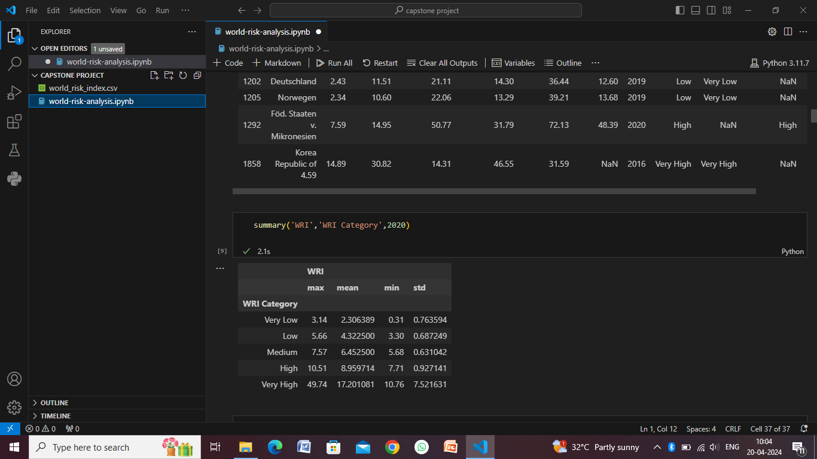
Result

Slide 9
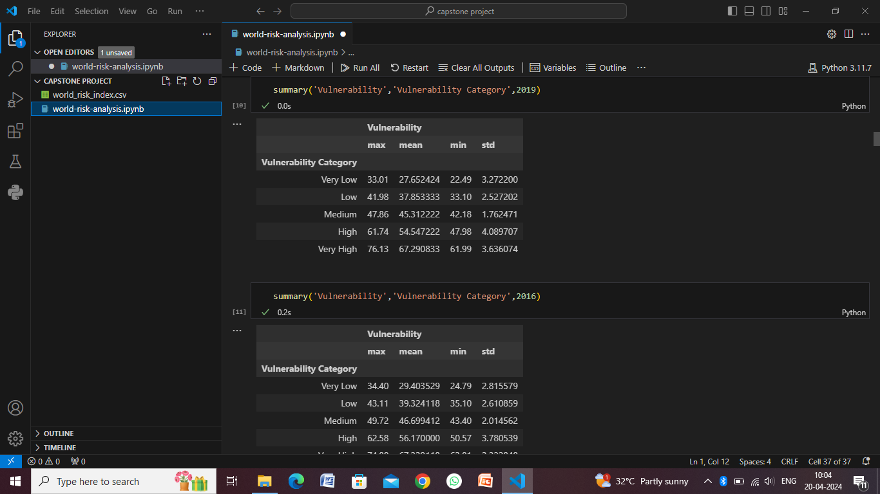
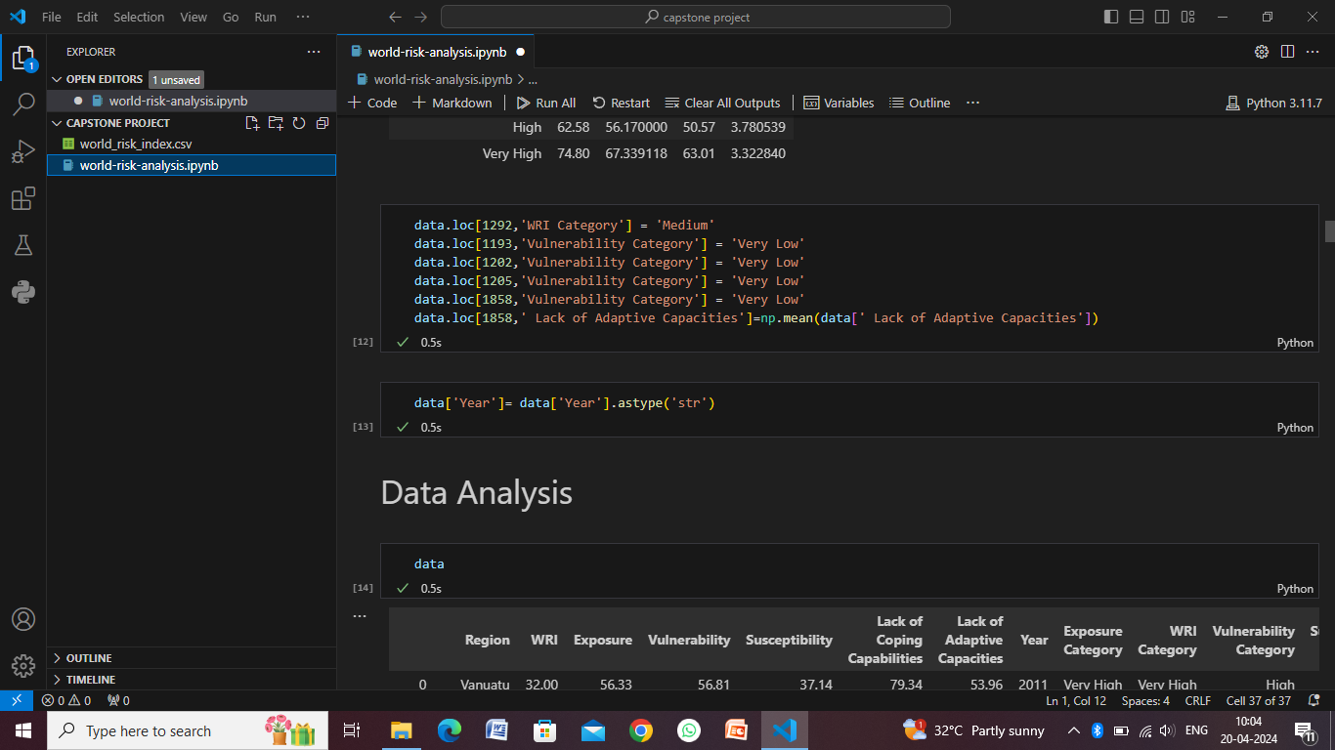
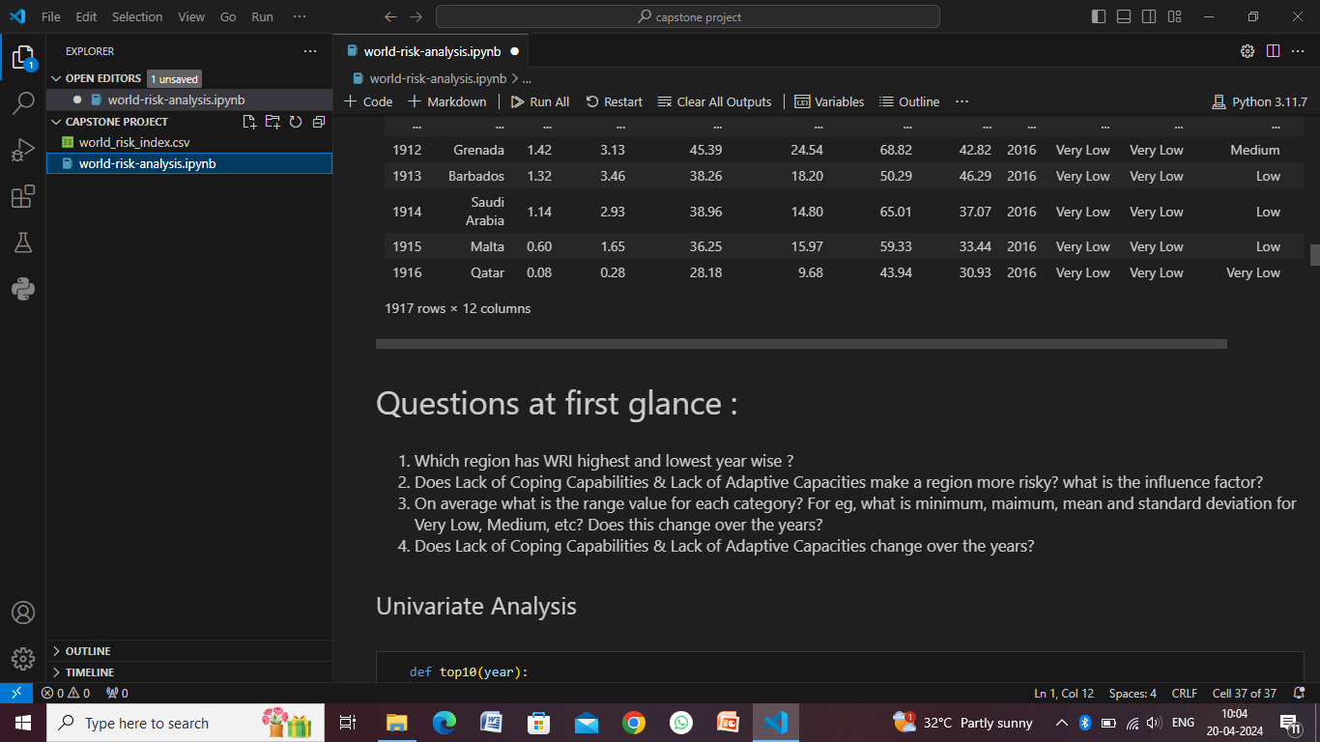
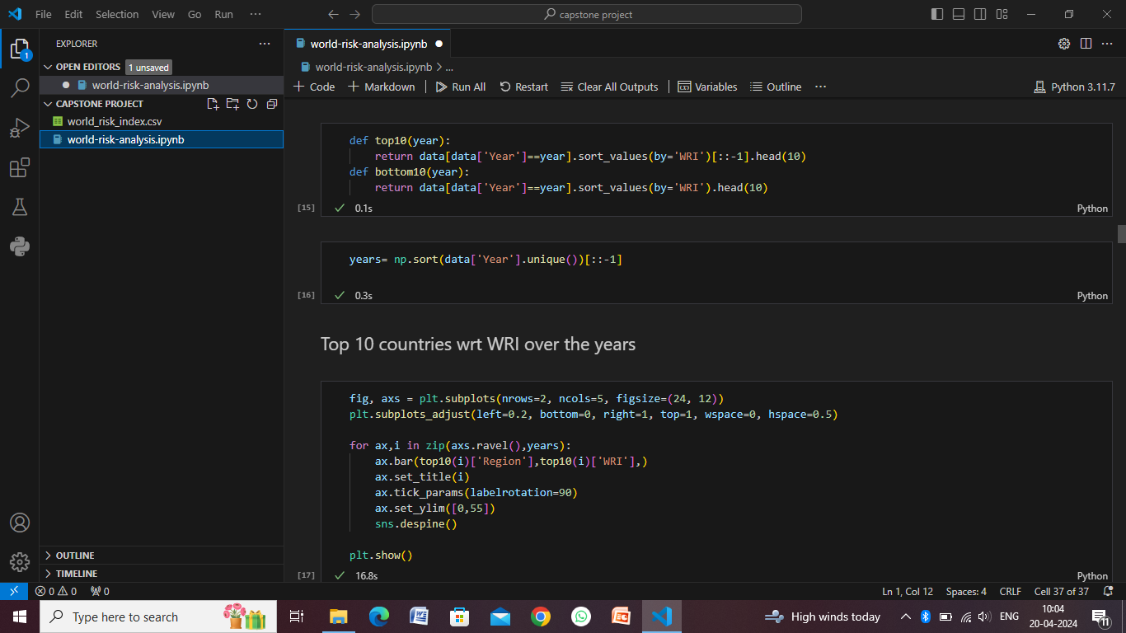

Slide 10
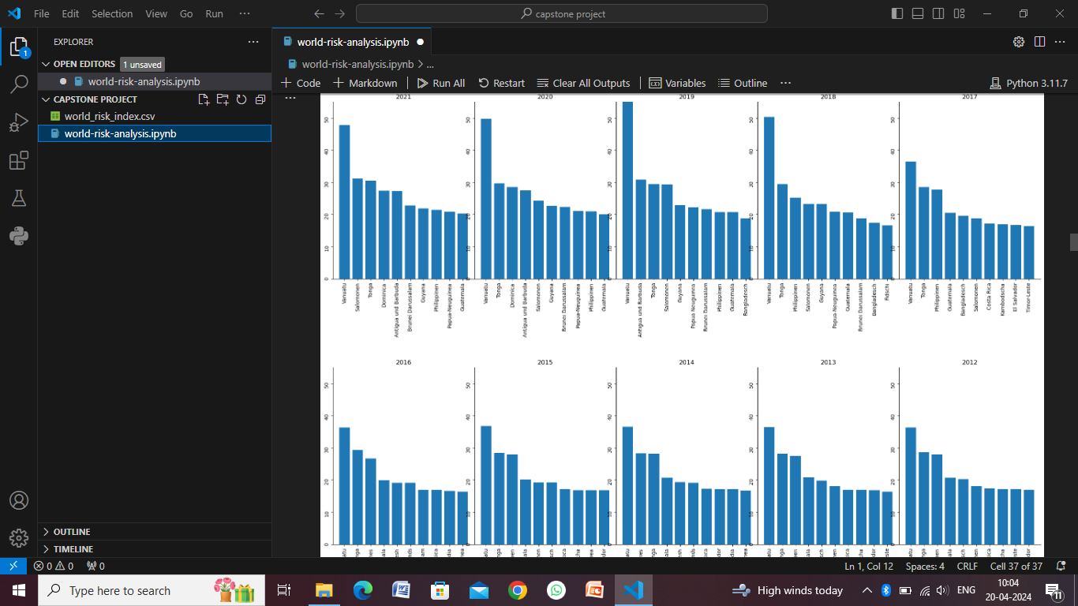
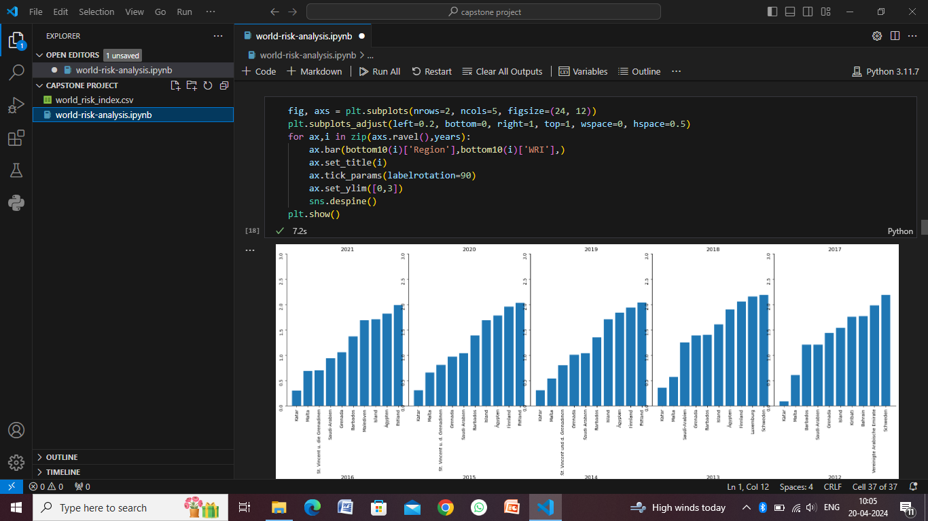
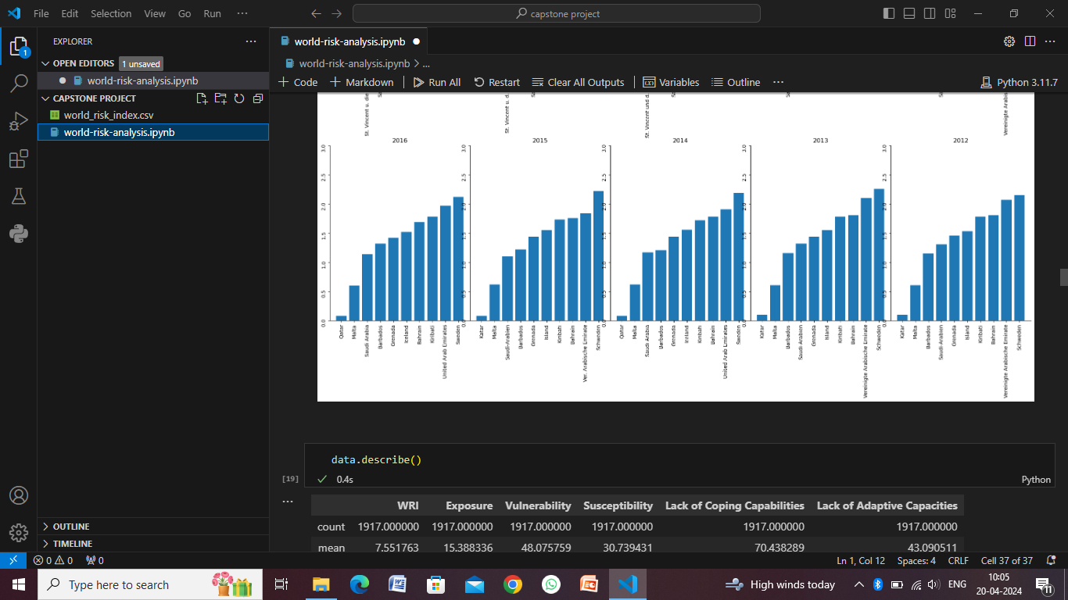
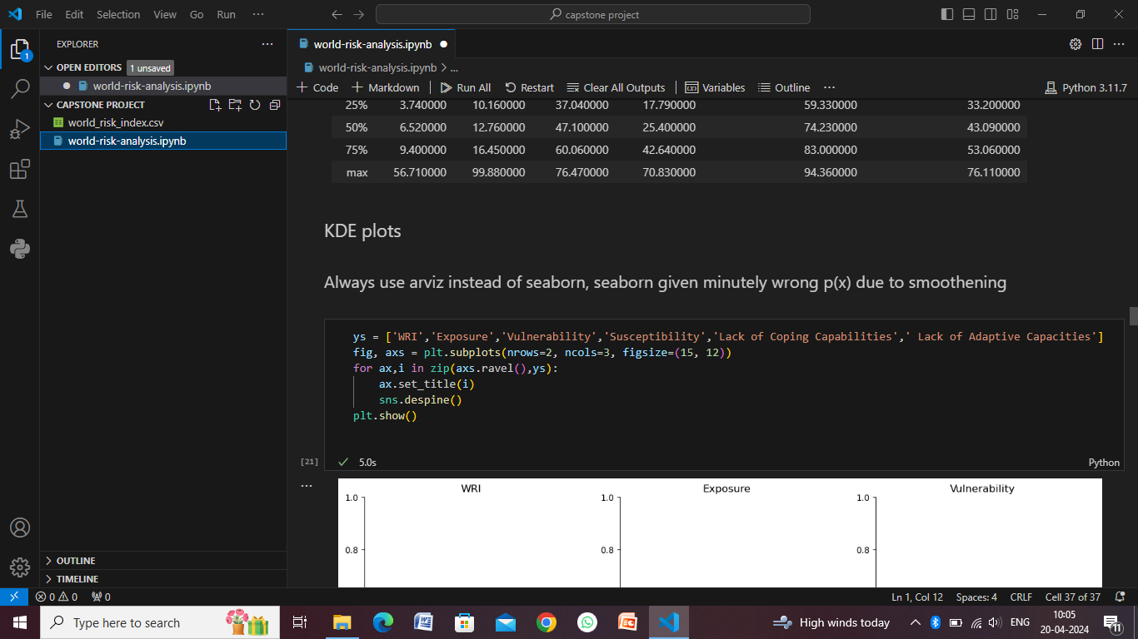

Slide 11
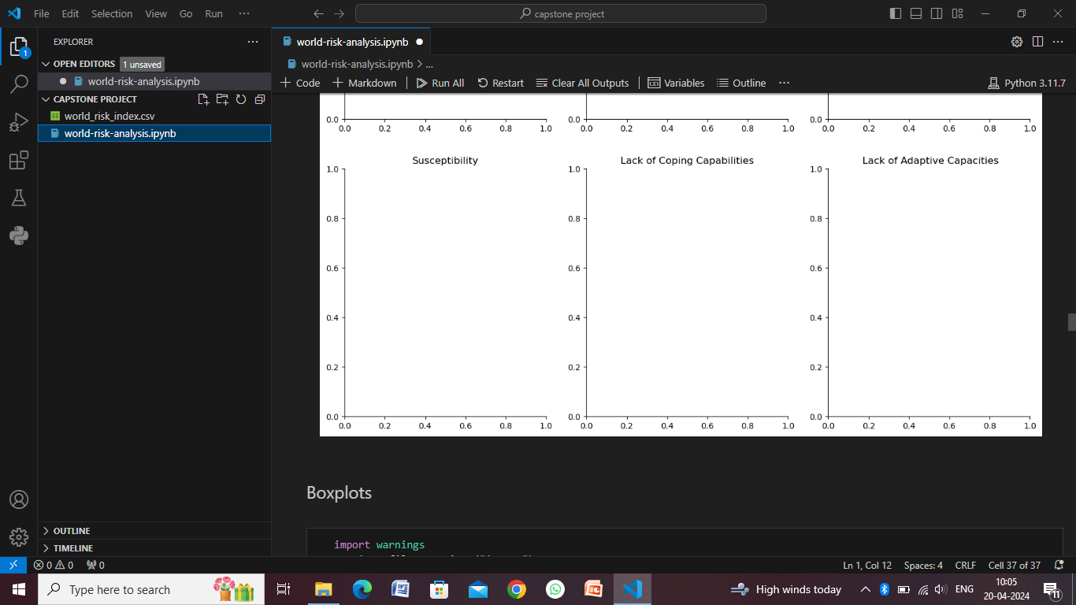
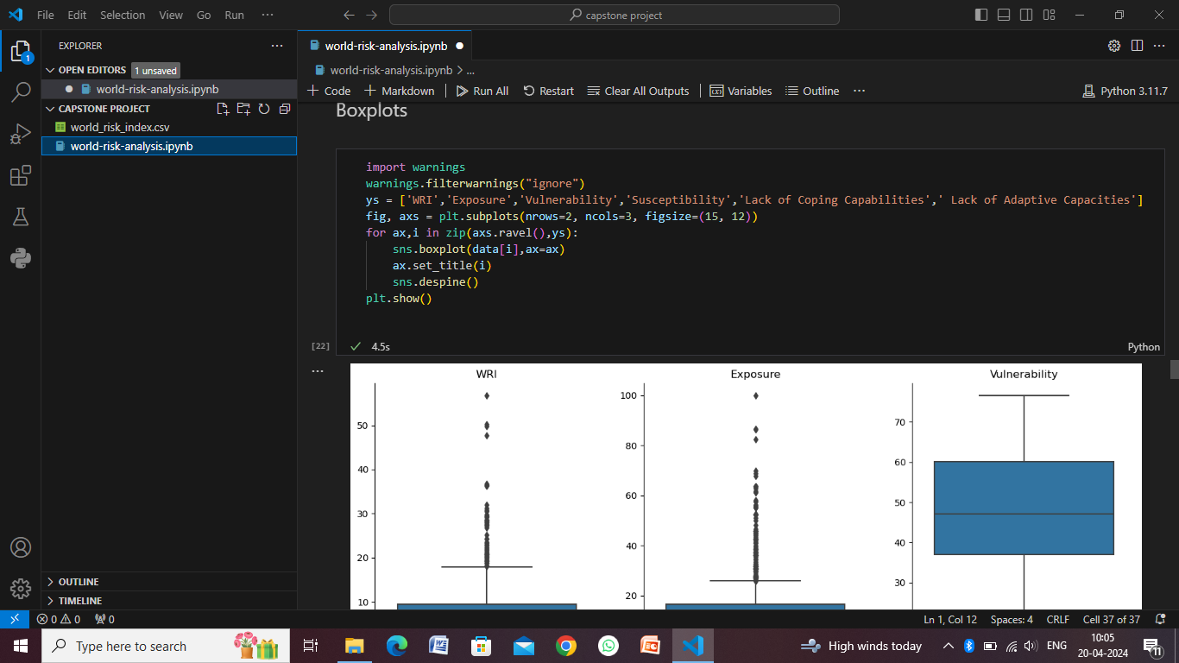
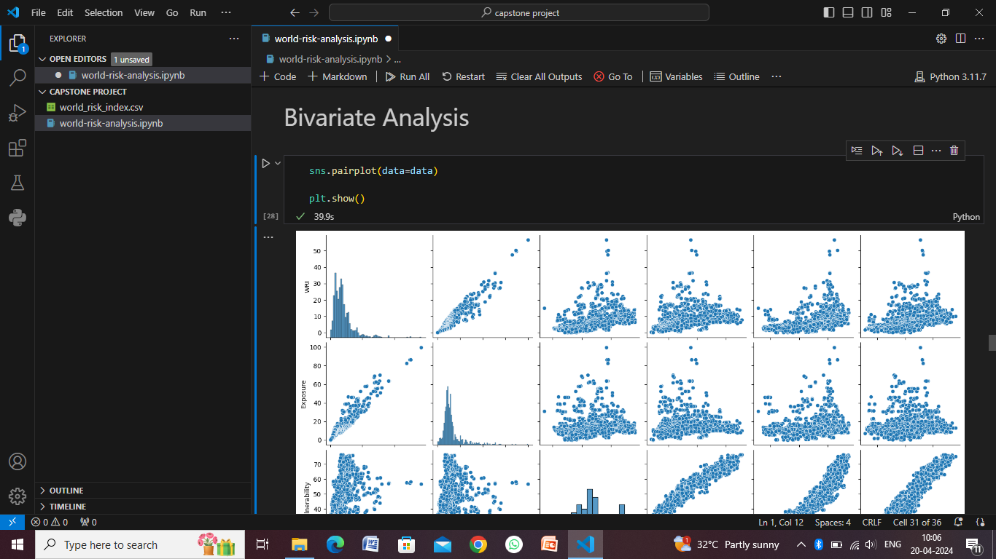
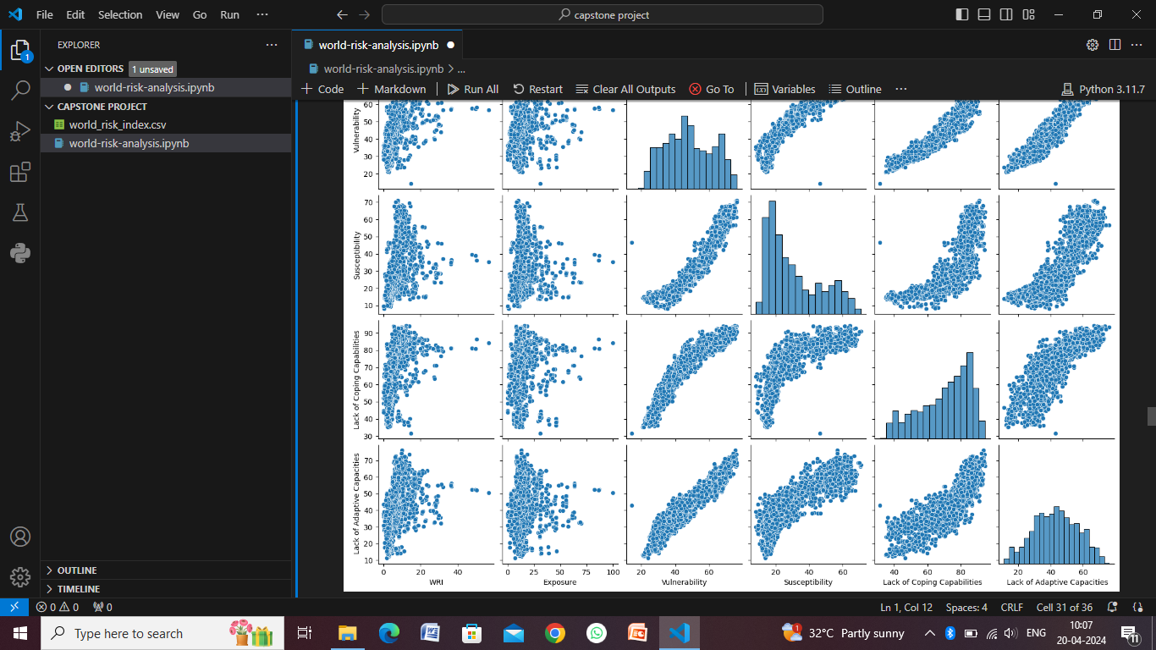

Slide 12
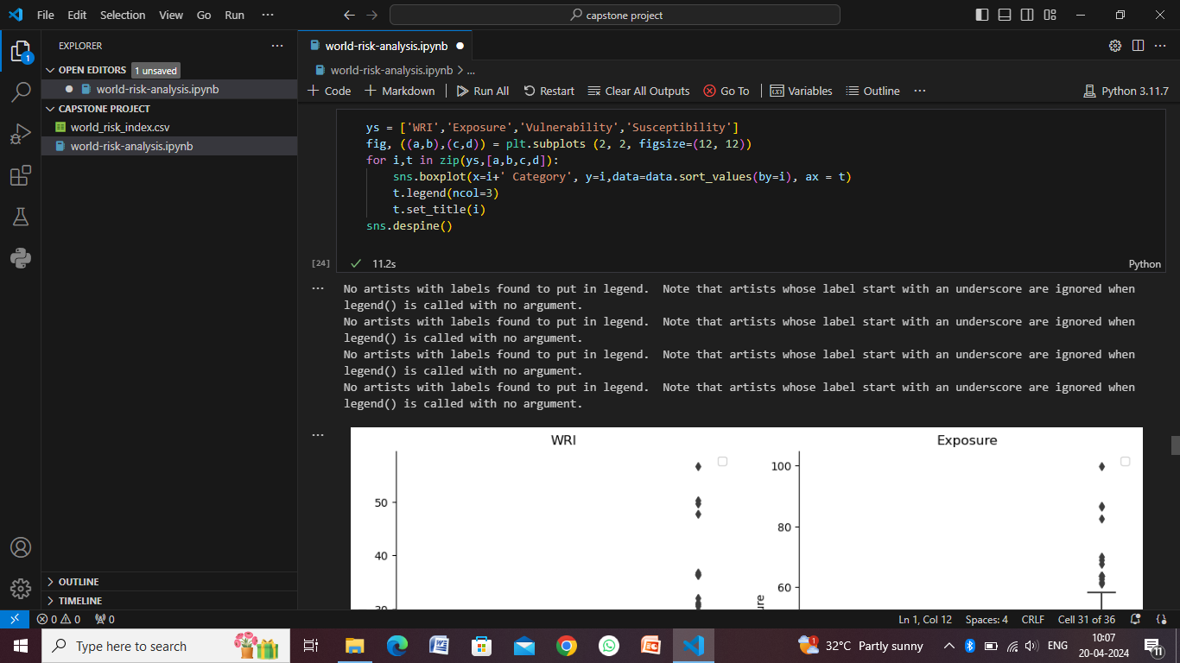
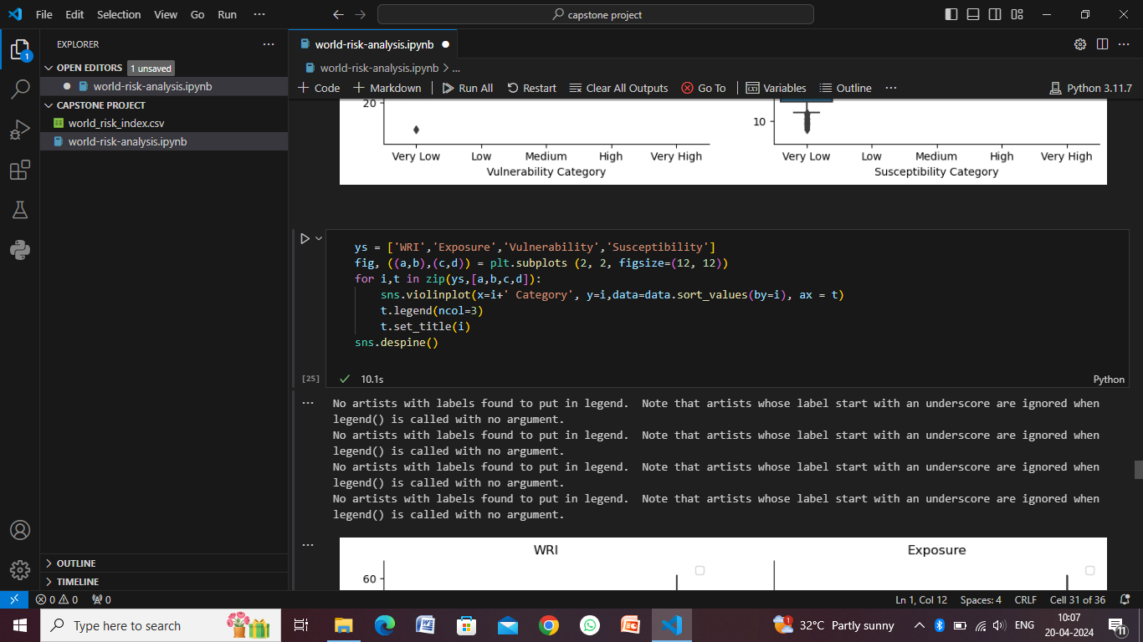
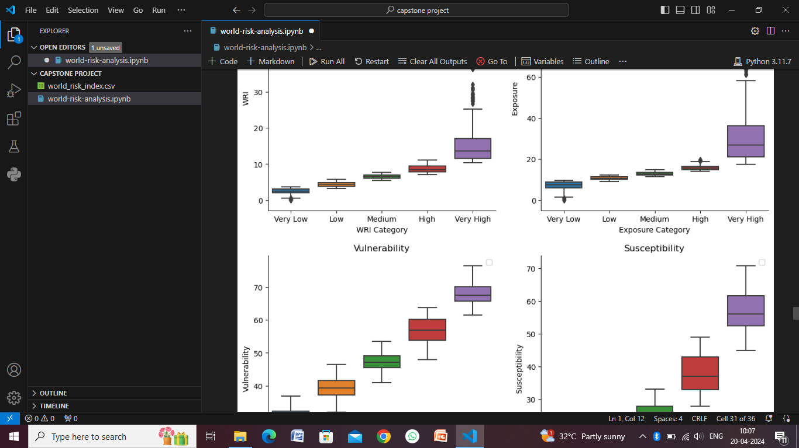
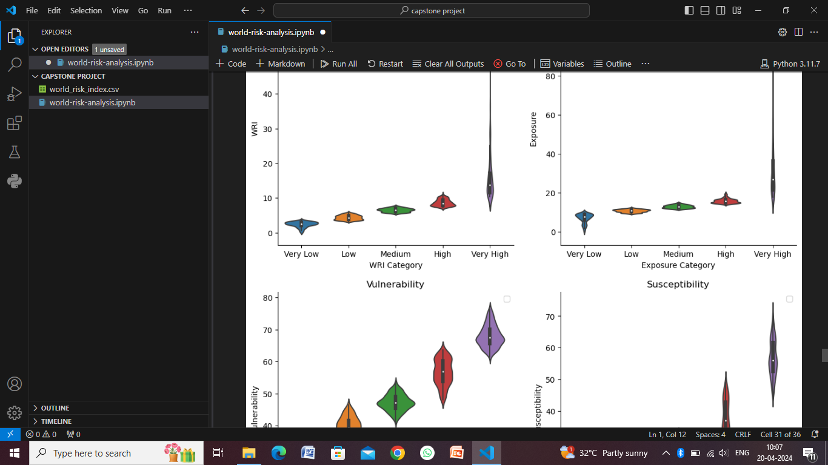

Slide 13
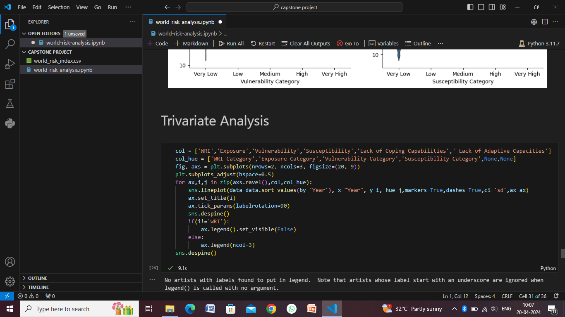
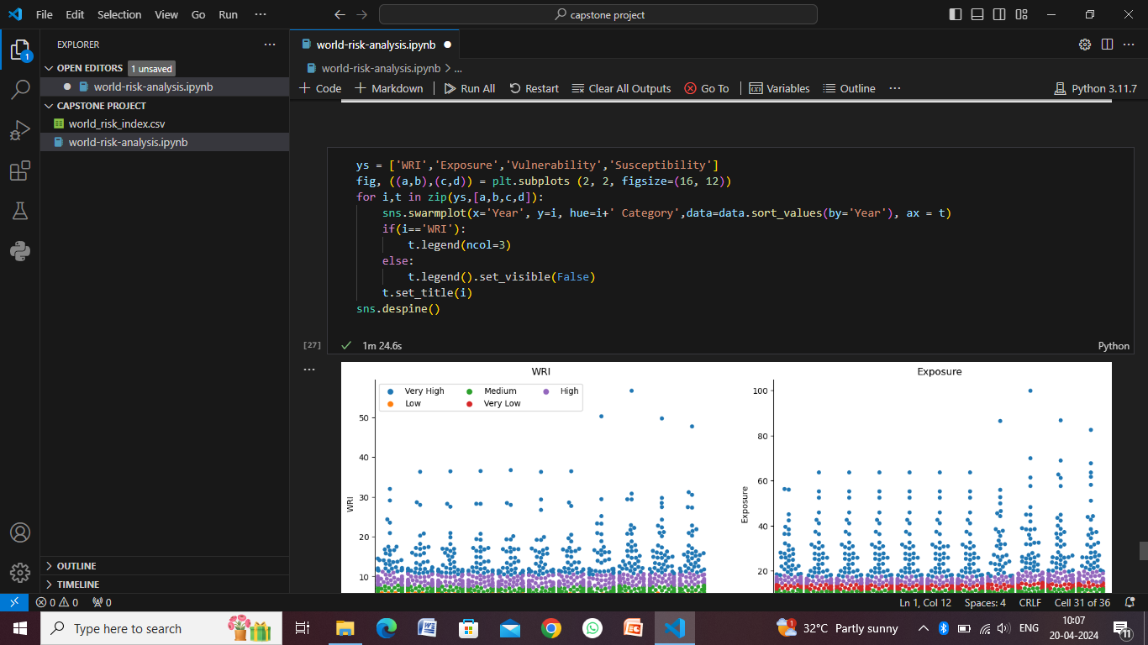
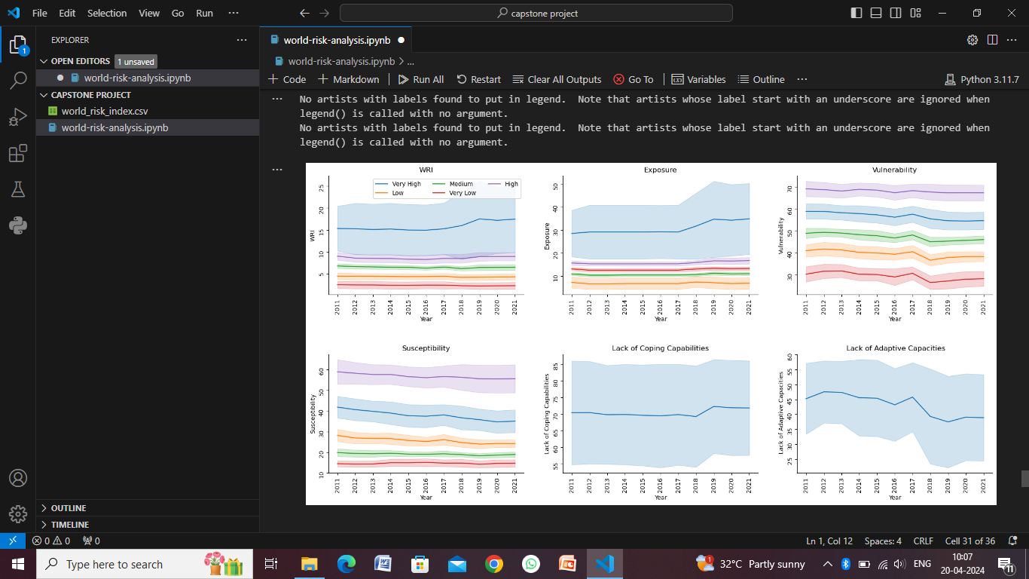
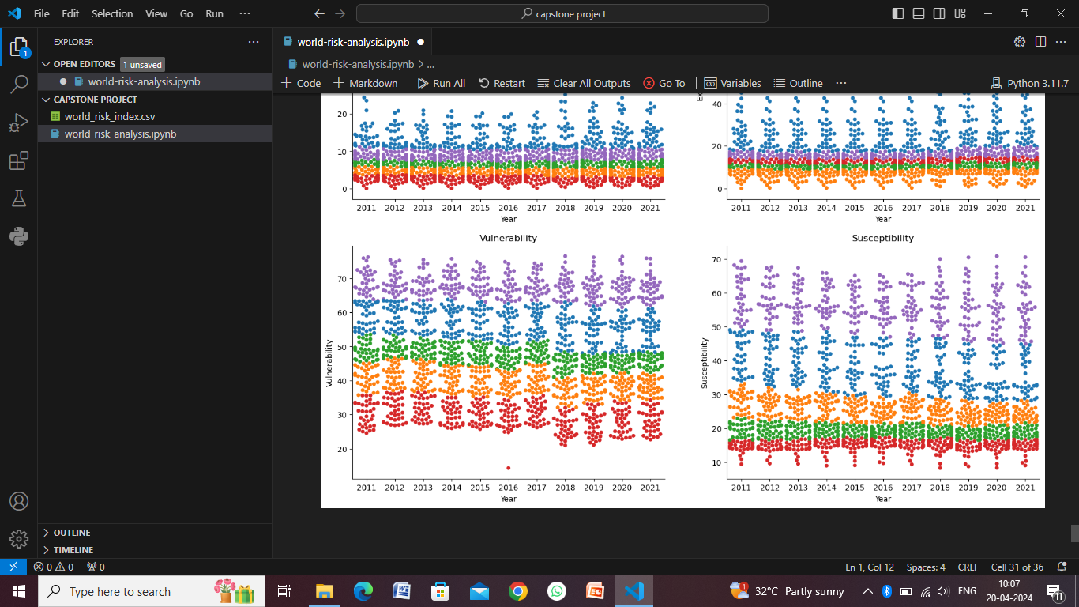

Slide 14
Conclusion
In conclusion, a comprehensive world risk analysis is a vital tool for understanding, prioritizing, and mitigating global risks across economic, environmental, geopolitical, and societal domains. Through a systematic approach that integrates data collection, risk assessment, prioritization, and mitigation strategy generation, stakeholders can gain valuable insights into complex risk landscapes and make informed decisions to enhance resilience and preparedness.

Slide 15
Future scope
The future scope of world risk analysis is expansive and dynamic, driven by technological advancements, evolving risk landscapes, global interconnectivity, and the increasing need for resilience in the face of complex challenges. Here are several areas that represent the future scope of world risk analysis:
Integration of Emerging Technologies
Enhanced Predictive Analytics
Climate Change and Environmental Risks
Health and Pandemic Risks
Geopolitical Instability and Conflict Risks
Supply Chain and Economic Risks
Social and Humanitarian Risks
Regulatory and Compliance Risks
Interdisciplinary Approaches

Slide 16
References
International Risk Governance Council (IRGC): The IRGC offers expertise and resources on risk governance, risk analysis, and risk management practices at the global level.
United Nations Office for Disaster Risk Reduction (UNDRR): UNDRR focuses on disaster risk reduction, resilience-building, and risk analysis globally, providing publications and tools for risk assessment and management.
OECD Risk Governance Initiative: The OECD's Risk Governance Initiative offers reports, guidelines, and case studies on risk governance, risk assessment, and regulatory approaches.
Risk Analysis Journal: The Risk Analysis journal publishes peer-reviewed research on risk analysis methodologies, case studies, and theoretical frameworks.
Journal of Risk Research: The Journal of Risk Research covers a wide range of topics related to risk analysis, risk management, and risk communication.
United Nations: The United Nations website provides access to reports, data, and publications on global risks, sustainable development goals, and international cooperation in risk management.
World Bank: The World Bank offers reports and resources on global risks, climate change impacts, disaster risk management, and resilience-building efforts.
European Union Agency for Fundamental Rights (EUAFR): The EUAFR focuses on fundamental rights and offers insights into social risks, human rights challenges, and risk assessment methodologies.
US Environmental Protection Agency (EPA): The EPA website provides data, tools, and reports on environmental risks, climate change impacts, and risk assessment approaches.

Slide 17
THANK YOU

